Slide 1



IUBAT–INTERNATIONAL UNIVERSITY OF BUSINESS AGRICULTURE AND TECHNOLOGY
Founded 1991 by Md. Alimullah Miyan
Development of Flat booking System for ICS system solution
Course Code: Practicum CSC 490
Prepared for: Practicum Defense Committee
Department of Computer Science & Engineering
Supervised by:
Faculty Name : Toyeer-E-Ferdous
Designation :Assistant Professor
Prepared by:
Student Name: MD. Ashraful Islam
Student ID: 22103051

Slide 2
Contents
Introduction
Organizational Overview
Project Overview
Key Features
Requirement Engineering
Use Case Diagram
System Planning
Risk Management
Activity Diagram
Entity Relationship Diagram
Data Flow Diagram
Testing
Conclusion
References

Slide 3
Introduction
This project provides a complete web-based system to manage customer accounts, property, booking, payments, and admin control with proper access roles.
The main goal of this system is to offer a single and scalable platform where customers can easily browse property, booking property, and make secure payments at lower effort.
The Online real estate project was developed to create a modern, secure, and user-friendly solution for online real estate property sell.
The system improves the overall property booking experience by bringing all features into one platform, reducing manual effort, and ensuring secure data handling using MERN stack.

Slide 4
Organizational Overview

Slide 5
Organizational Overview
ICS System Solution that provides IT consulting and services for software development, web promotion and SEO consulting, website and mobile application design and development, and e-commerce implementation.
ICS System Solution has significantly increased its level of competence and successfully completed projects of all sizes, offering end users, companies, associations, and organizations solutions.
Organization Services
Web Development
Customer Software Development

Slide 6
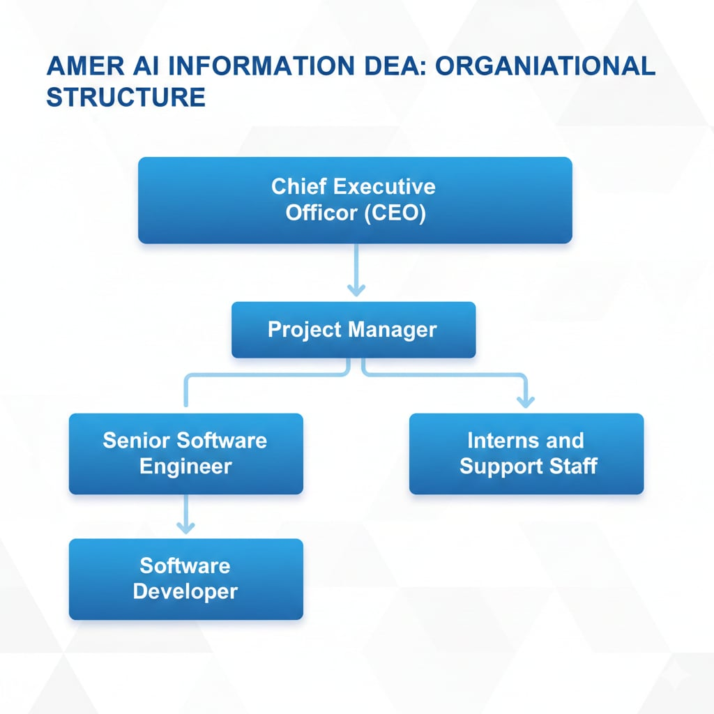
Organizational Structure

Slide 7
Background Study
The Online flat booking system was developed to address the challenges of fragmented offline flat booking markets.
It provides a secure, full-stack e-commerce solution built with MERN stack for browsing, booking , and selling properties.
The main goal is to create a centralized, scalable platform that makes booking property easier and more convenient for customers.
The system unifies property browsing, booking management, payment, and admin monitoring in one platform.
It ensures secure transactions, proper stock management, and data integrity for reliable operations.

Slide 8
Project Overview

Slide 9
Project Objectives
Design and develop a multi-vendor real estate marketplace named FlatSell
Enable customers to browse property, booking, pay.
Allow Admin to manage property and customer booking
Provide Admin control for user, property, vendor, and system management
Integrate secure payment (Stripe) and invoice generation
To generate sales and profit reports for better business analysis.
To build a user-friendly, secure, and efficient web-based system.
Support flexible monthly installment plans (1–24 months) with secure online payments.
Automate booking policies: payment-inactivity cancellation, voluntary refunds, and per-user booking limits.
Track vendor commissions and platform margin with PDF sales & revenue reports.

Slide 10
Key Features
Multi-vendor marketplace with role-based access: Super Admin, Company Admin (Vendor), and Customer.
Three property categories — Apartment, Villa, Land — with an interactive unit / floor-plan visualizer.
Cloudinary media uploads and map-based location selection (Leaflet / OpenStreetMap).
OTP email verification, JWT (HttpOnly cookie) authentication, and protected routes.
Stripe payments: booking money, remaining due, and per-installment payments.
Flexible installment plans (1–24 months) with tiered service charge and automatic late fee.
Commission & platform-margin tracking with downloadable PDF sales and revenue reports.
Automated PDF invoices and email notifications at every stage.

Slide 11
Booking Policies (Automated)
Policy 1 — Auto-Cancellation: a daily scheduled job warns the customer at 2 months of payment inactivity and auto-cancels the booking (no refund) at 3 months; the unit is released.
Policy 2 — Voluntary Refund: customer may request a refund within 1 month; 20% retention fee is kept and the remaining 80% is refunded from the vendor's wallet (ledger updated, both parties notified).
Policy 3 — Booking Limits: max 2 active bookings per vendor and 5 active total per user; Super Admin can grant per-user overrides with a reason.
All thresholds (months, retention %, limits) are configurable from the Super Admin Platform Settings — no code changes required.
Every policy action is recorded in an audit trail for full traceability.

Slide 12
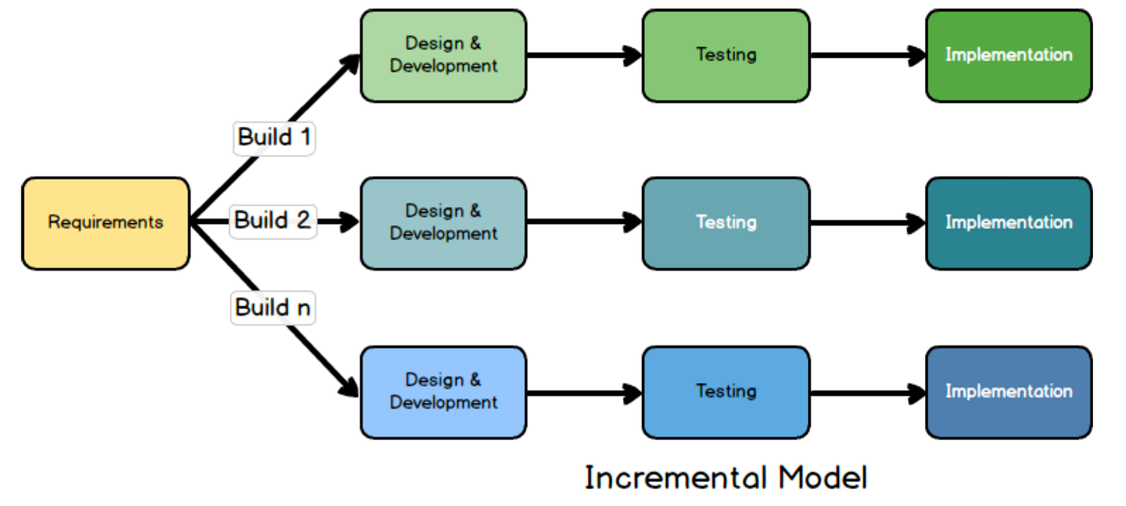
Process model

Slide 13
Process model
The system was built step by step instead of all at once.
The whole project was divided into small and easy-to-handle parts.
Each part was planned, developed, and tested one by one.
After completing each step, a usable version of the system was available.
New features were added only after the previous part worked properly.
This method helped reduce mistakes and improve the overall quality of the system.

Slide 14
Process model
Why This Development Model Was Chosen
It allows easy management of a large system by breaking it into parts.
Errors can be identified and fixed early at each stage.
New requirements or features can be added without affecting the whole system.
Suitable for web-based systems with multiple features like users, booking, and payments.
Provides flexibility, better control, and proper documentation.
Ideal for academic projects with limited time and resources.

Slide 15
Requirement Engineering

Slide 16
User Requirements
1.1 SuperAdmin:
Platform Oversight: Needs complete visibility and control over all platform activities, including properties, companies, and users.
Approval Workflows: Needs the ability to review and approve/reject property submissions and new vendor (company) applications.
Financial Tracking: Needs a comprehensive dashboard to track platform revenue, margins, and commissions from successful property bookings.
Platform Configuration: Requires access to system-wide settings to manage platform policies and overall configurations.

Slide 17
User Requirements
1.2 Company Admin (Vendor):
Property Management: Needs the ability to list, edit, activate, deactivate, and delete their own properties (Apartments, Villas, Land).
Lead/Booking Management: Needs a dedicated workspace to view and manage customer inquiries and property booking requests.
Submission Tracking: Requires transparency on the approval status of their submitted properties.
Policy Management: Needs to define custom booking policies and terms specific to their company's properties.

Slide 18
user Requirements
1.3 Customer / User:
Property Search & Viewing: Needs an intuitive interface to search, filter, and view detailed information about available properties.
Booking & Purchasing: Needs a streamlined workflow to request units, pay booking money, and settle remaining dues securely.
Dashboard & Tracking: Needs a personal dashboard to track the status of property requests, view payment statuses, and manage owned properties.
Communication: Needs clear notifications regarding the status of their bookings (Pending, Confirmed, Rejected, Cancelled).

Slide 19
Requirements
Functional Requirements
Frontend: React.js + Tailwind CSS | Backend: Node.js + Express.js | Database: MongoDB
REST API endpoints for: User & Vendor registration/login (OTP + JWT) • Property & Unit management (CRUD) • Vendor application & approval • Booking, booking-money, due & installment payments (Stripe) • Commission, sales & margin reports • Booking policies (auto-cancel, refund, limits). Responsive UI for desktop and mobile devices.

Slide 20
Requirements
Non-Functional Requirements
Secure password storage using hashing.
Input validation for all forms.
Fast response times for APIs.
Invoice & Report generation .
Basic error handling and notifications for users and admin.
JWT authentication via secure HttpOnly cookies and role-based access control.
API rate limiting and security headers (Helmet, sanitization) against common attacks.
Responsive, mobile-friendly UI built with Tailwind CSS.

Slide 21
Hardware & Software Requirements
Hardware & Software Requirements
Client/Server side: Intel Core i7, 4GB/8GB RAM, 128GB+ SSD.
Software Requirements:
Backend: Node js, Express js
Frontend: React js, Tailwind CSS
Database: MongoDB.
Other Services: Stripe API.
Media/File Storage: Cloudinary.
Email/OTP: Nodemailer (Gmail SMTP).
Auth: JSON Web Token (JWT). Maps: Leaflet / OpenStreetMap.

Slide 22
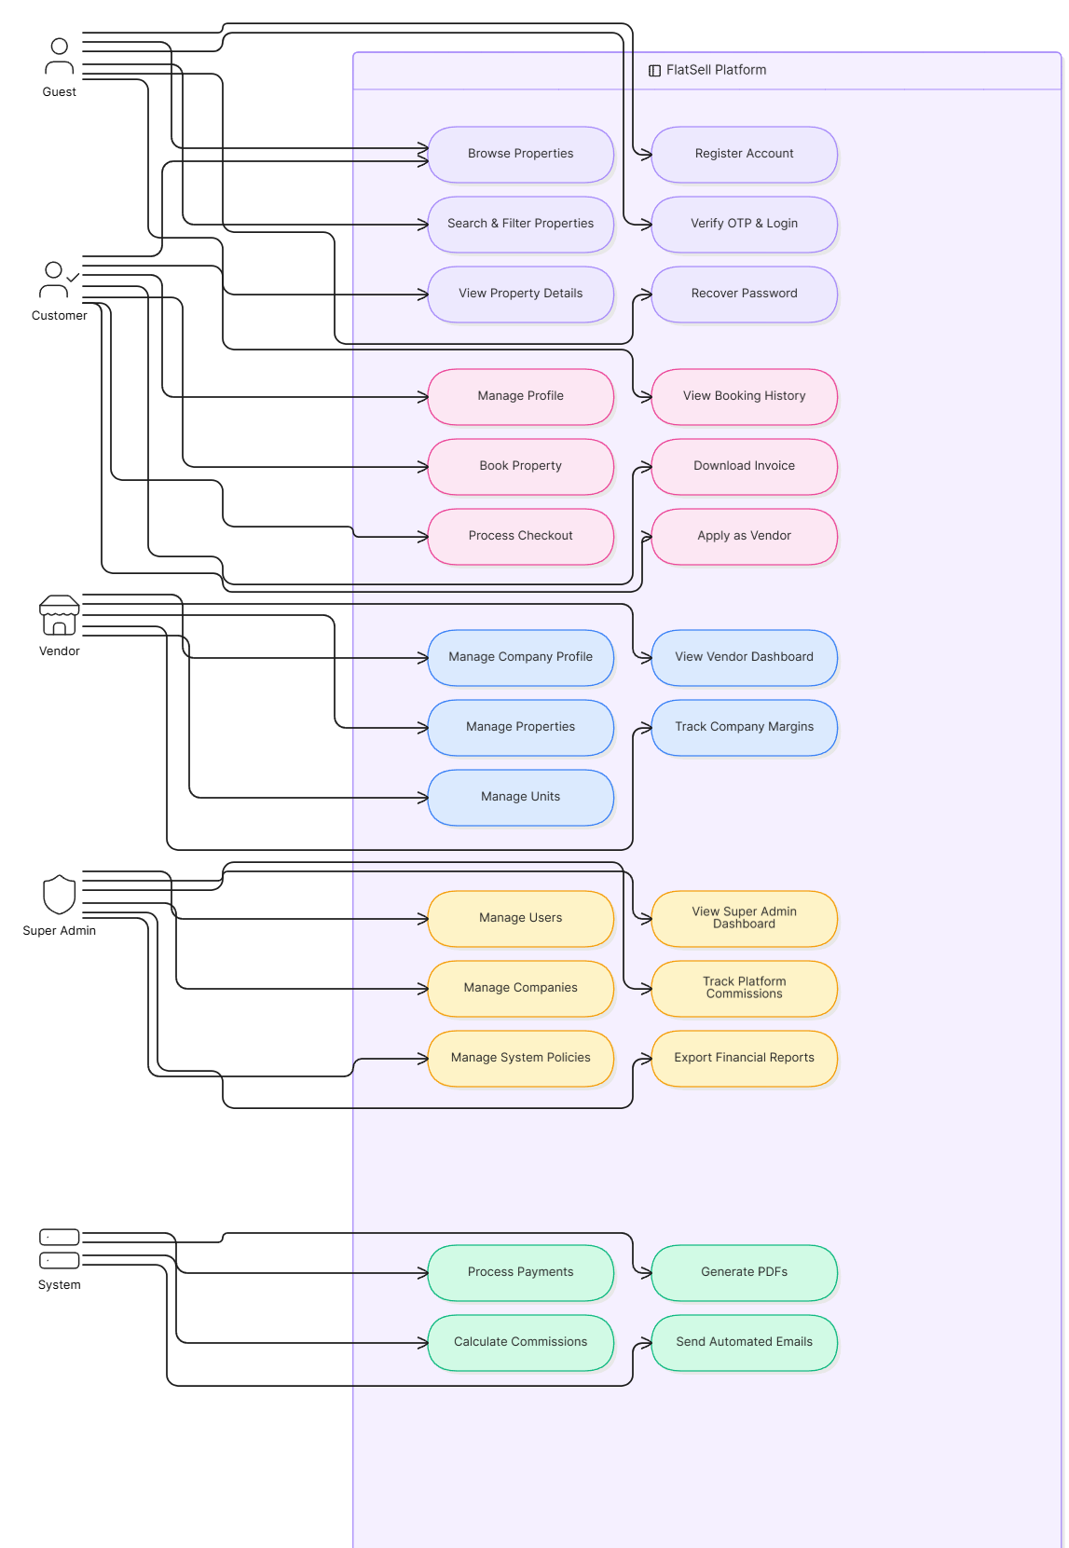
Use Case Diagram
Fig- Use Case

Slide 23
System Planning

Slide 24
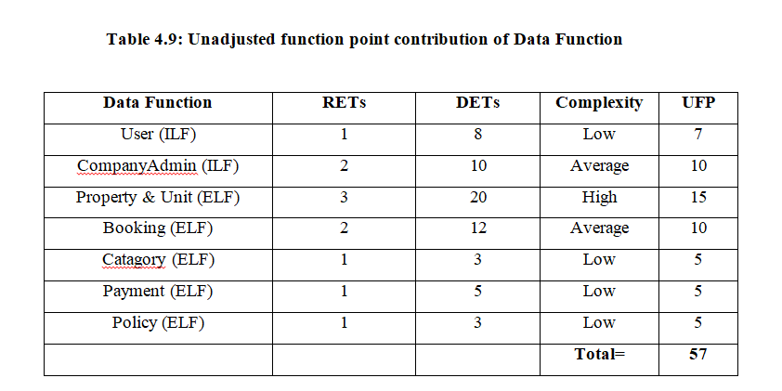
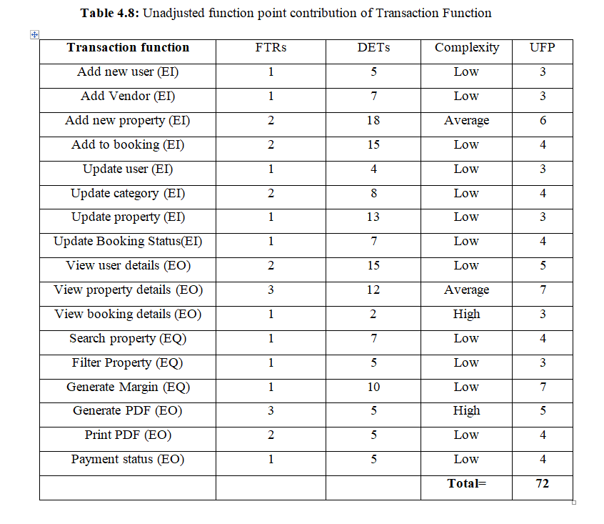
Function Point Estimation

Slide 25
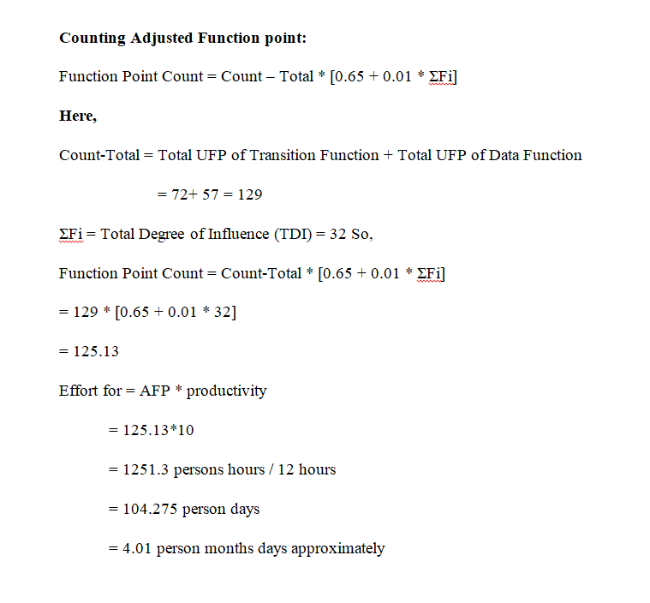
Function Point Estimation

Slide 26
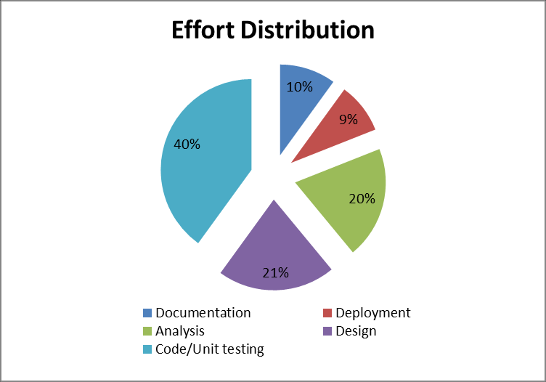

Slide 27
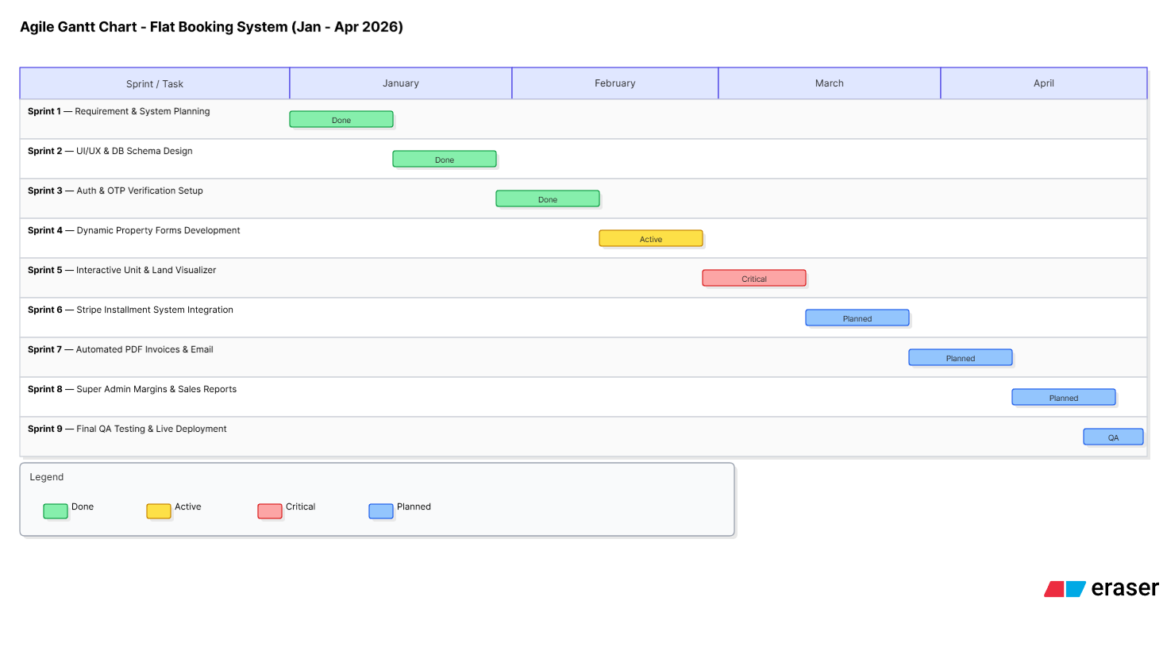

Slide 28
Risk Management

Slide 29
Risk Management
Table : Project Risk
Project Risk
Name | Change the requirements
Probability | Low(25%)
Impact | Marginal (2)
Description | Customer can change the requirements.
Mitigation and Monitoring | The firm characterizes needs in response to deadlines or practical circumstances. There will be regular company meetings. This ensures that the issue is addressed in the finished product.
Management | All parties must meet immediately to discuss the new project's objectives and aims.
Status | Not occur

Slide 30
Risk Management
Table Business Risk
Business Risk
Name | Insufficient Budget.
Probability | Low (10%)
Impact | Marginal (2)
Description | A project may not be finished if the budget is too little.
Mitigation and Monitoring | The project requires the construction of an expensive streaming server. To decrease the financial risk, we search for several alternative streaming service providers.
Management | Project aim clarification. a fresh approach to budget control.
Status | Problem solved

Slide 31
Risk Management
Table 5.4 Technical Risk
Technical Risk
Name | Computer Crash
Probability | Moderate (25-40%)
Impact | Catastrophic (1)
Description | Computer may crash due to several reasons.
Mitigation and Monitoring | Computers must be adequately monitored. In reality, to avoid unintentional shutdowns, we regularly backup our data and have an intrusion detection system in place.
Management | If our computer crashes, we'll restore the backup.
Status | Managed.

Slide 32
Diagram

Slide 33
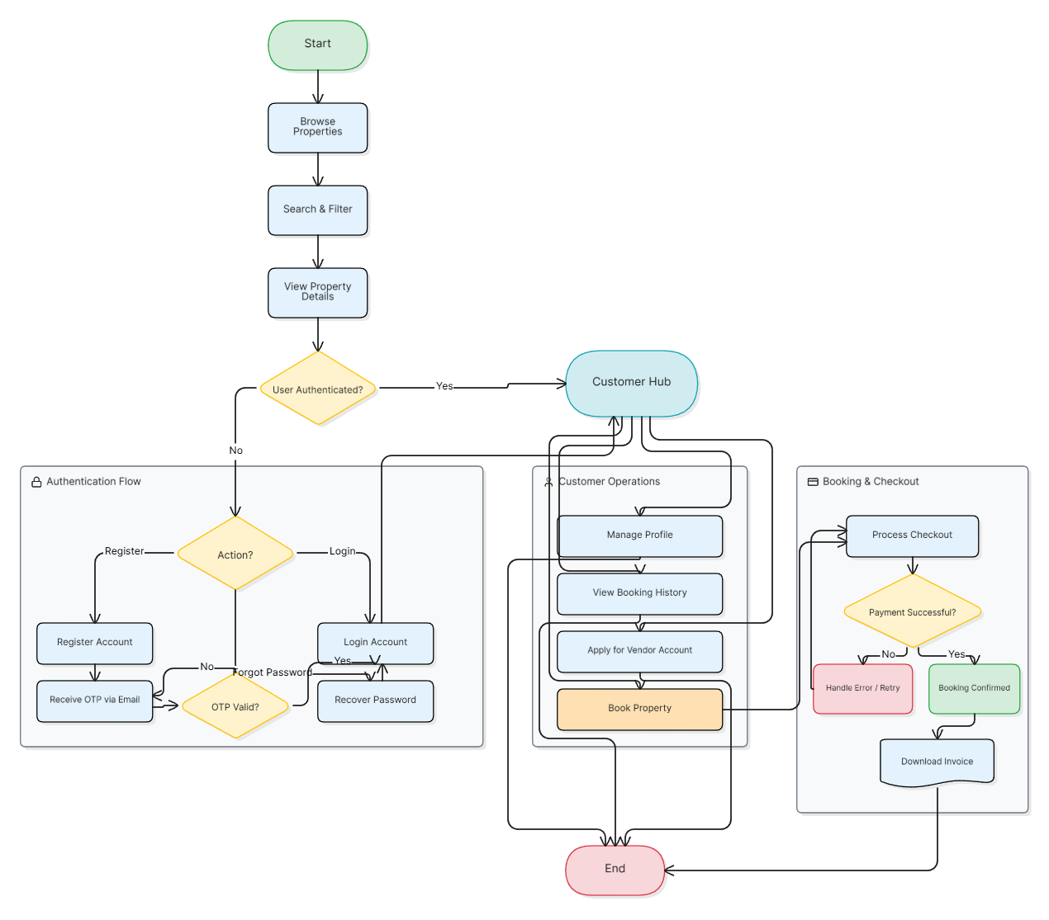
Activity Diagram
Fig-Activity Diagram of User

Slide 34
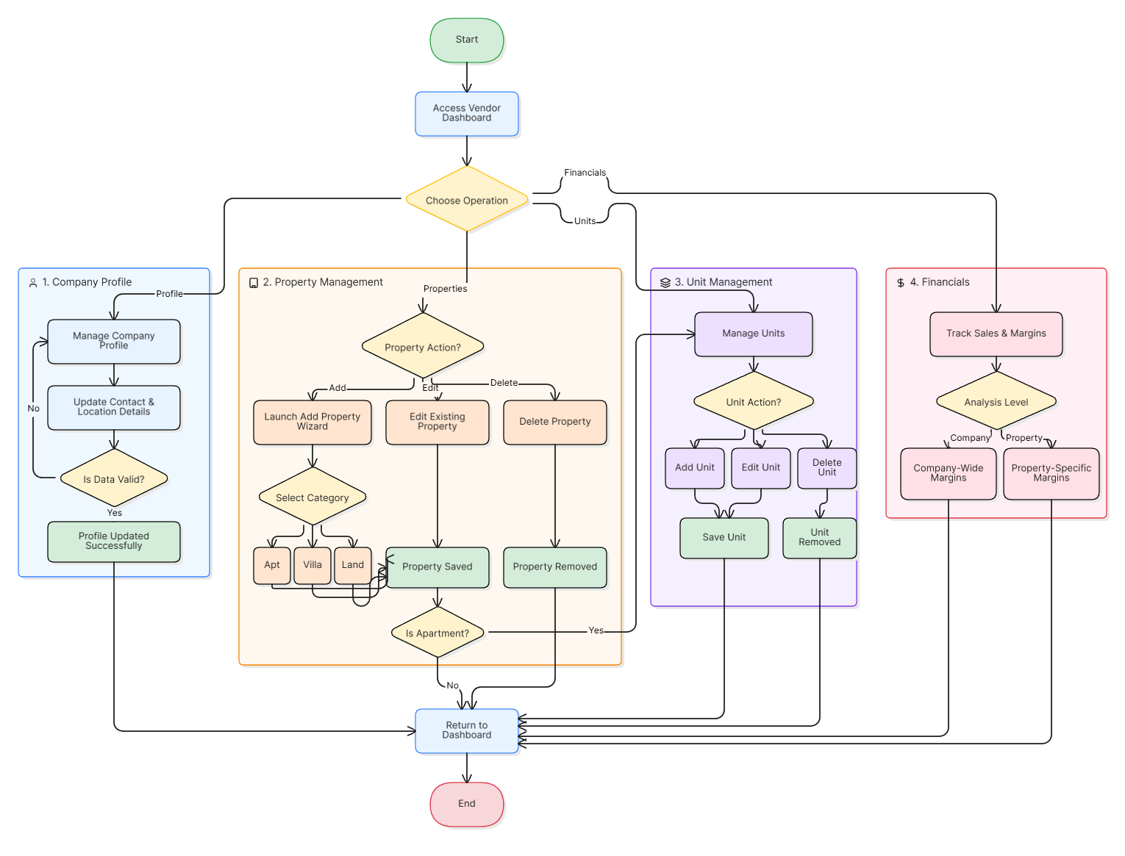
Activity Diagram
Fig- Activity Diagram of Vendor

Slide 35
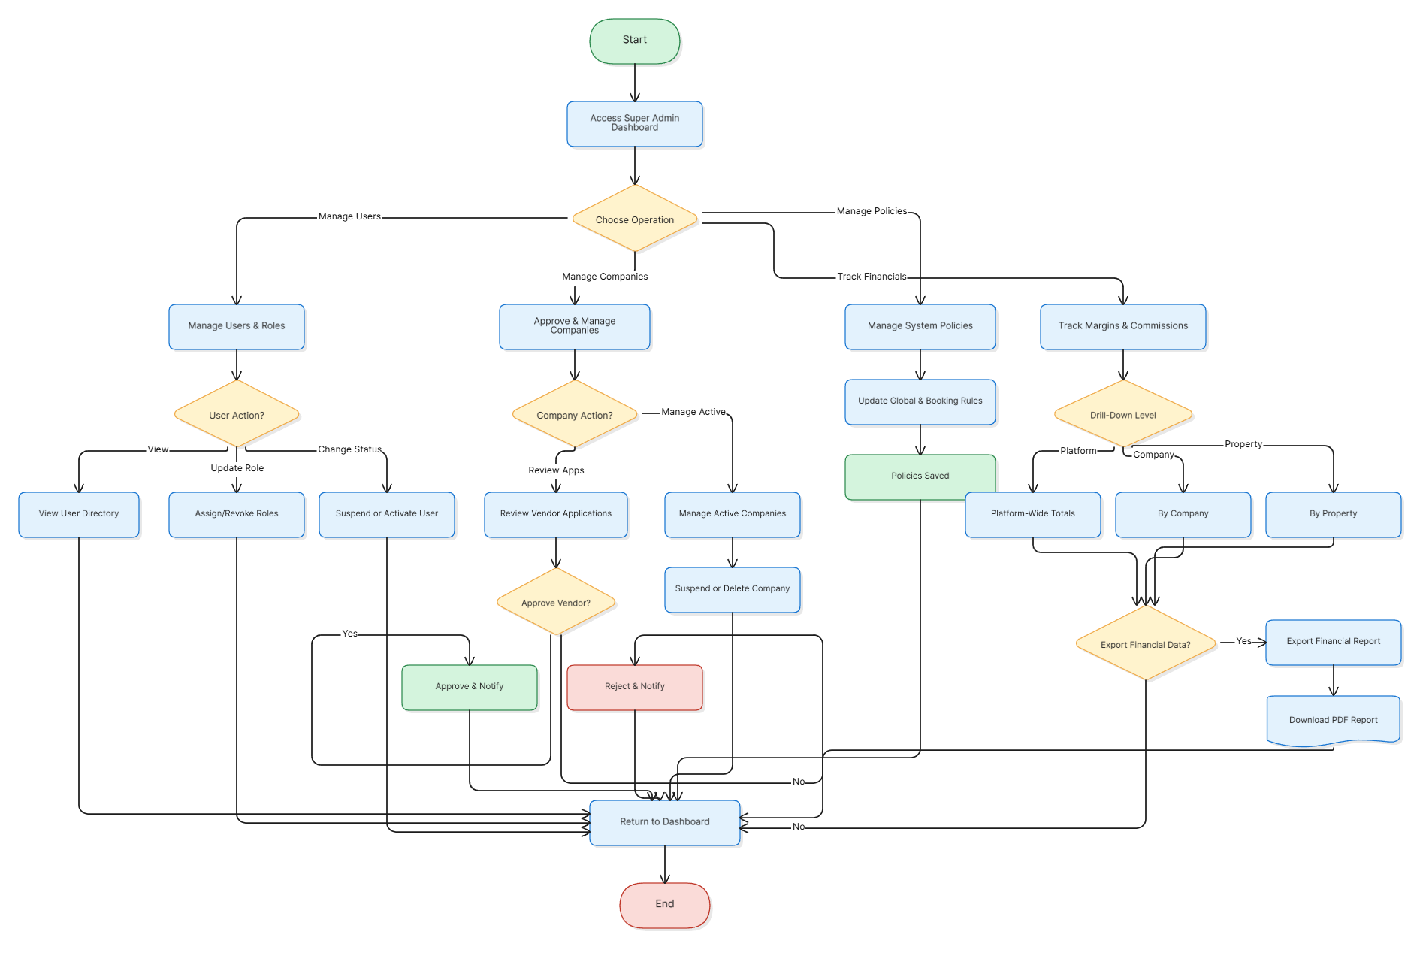
Activity Diagram
Fig- Activity Diagram of Super Admin

Slide 36
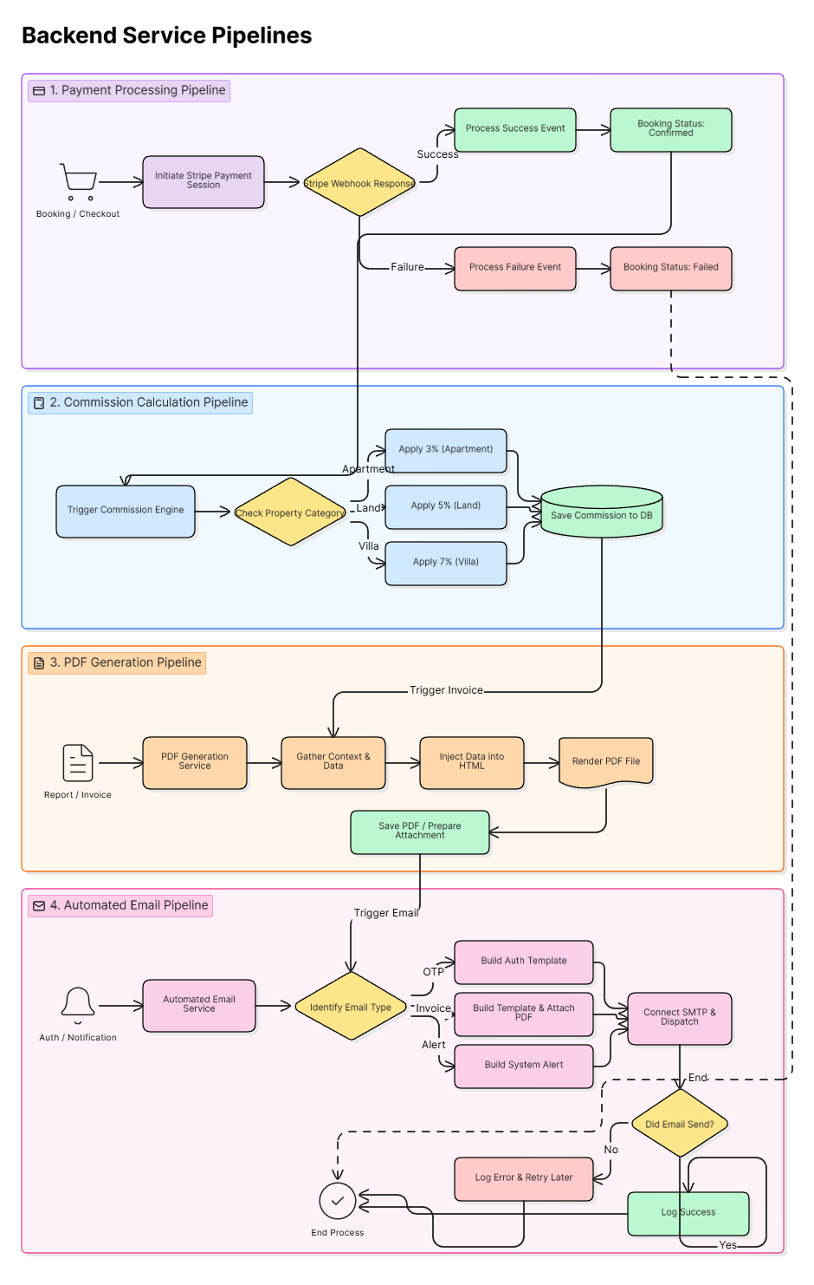
Activity Diagram
Fig- Activity Diagram of System

Slide 37
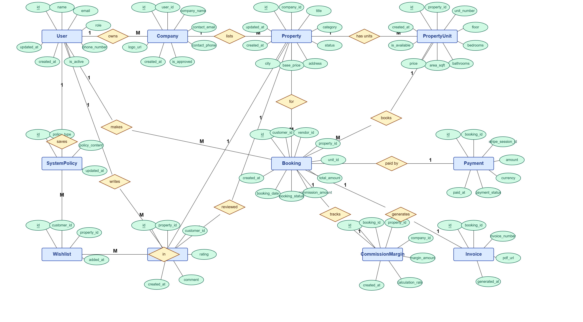
ERD
Fig : ERD diagram

Slide 38
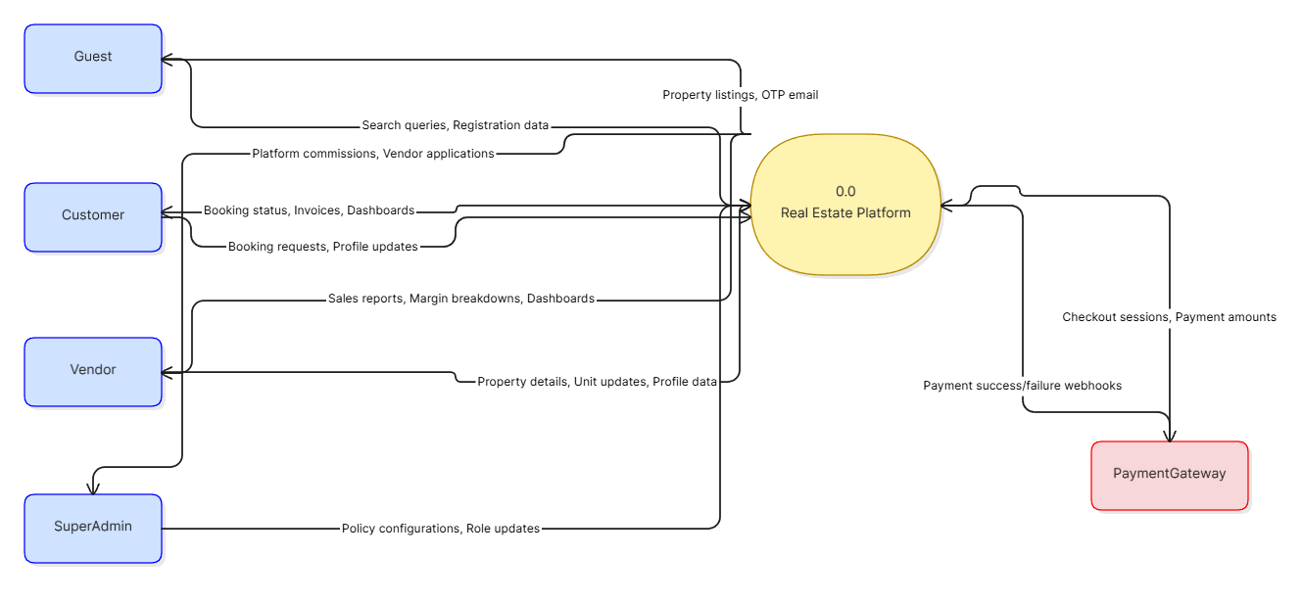
Data Flow Diagram
Figure: Context Level DFD

Slide 39
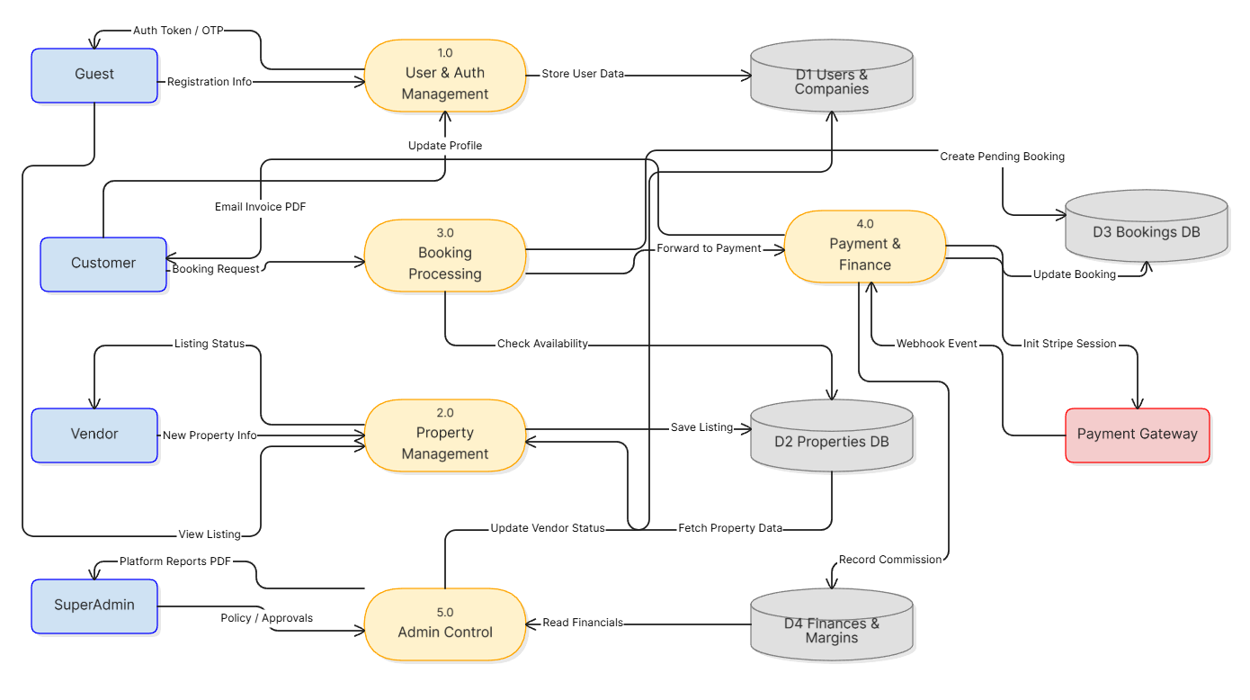
Data Flow Diagram
Figure: Level 1 DFD

Slide 40
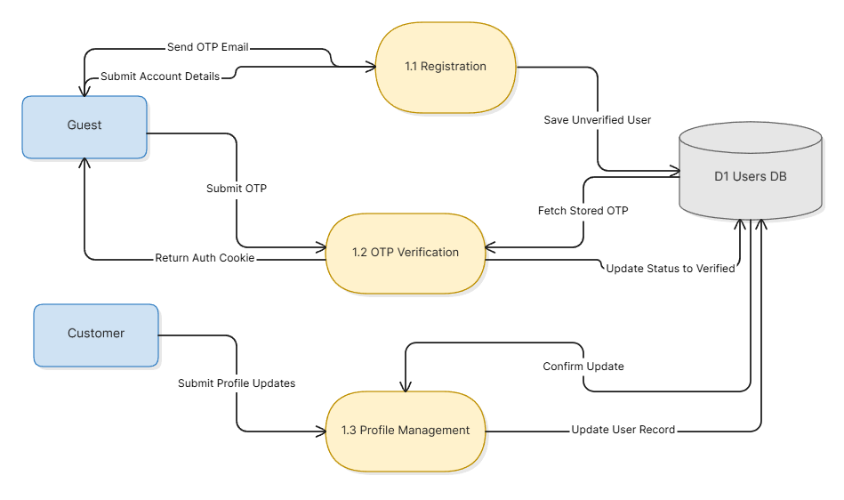
Data Flow Diagram
Figure: Level 2 DFD process 1(Login/out)

Slide 41
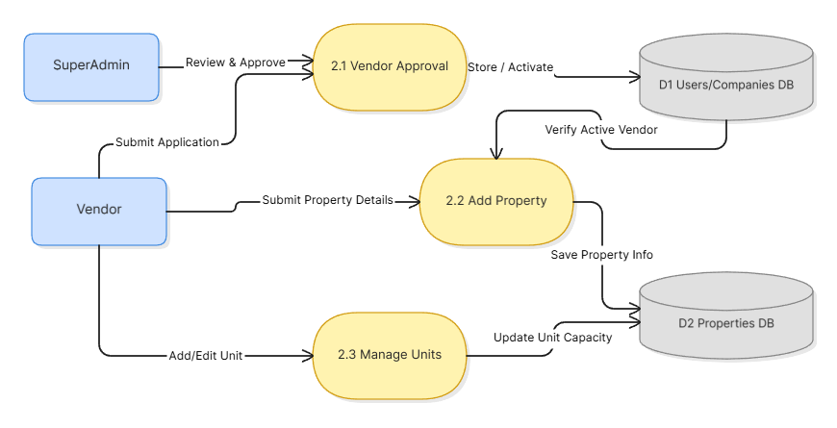
Data Flow Diagram
Figure: Level 2 DFD process 2

Slide 42
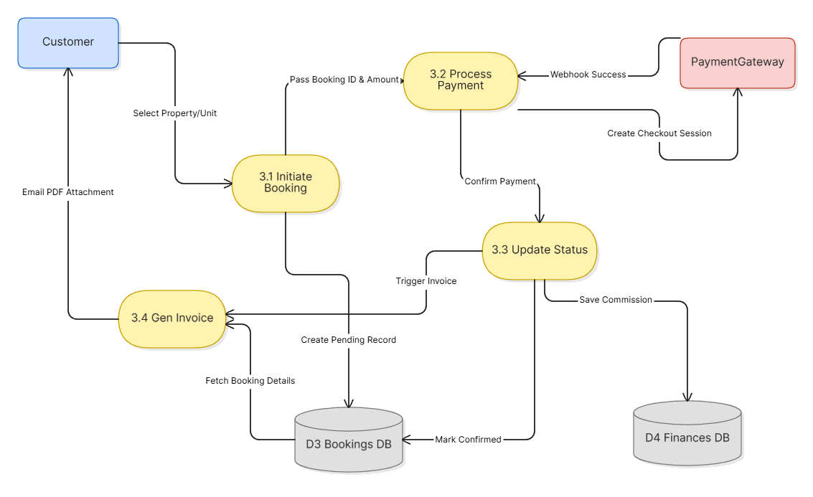
Data Flow Diagram
Figure: Level 2 DFD process 3

Slide 43
Testing

Slide 44
System Testing
Various verification scenarios were conducted to check that the software performs as required, incorporating both
black-box and
white-box testing.

Slide 45
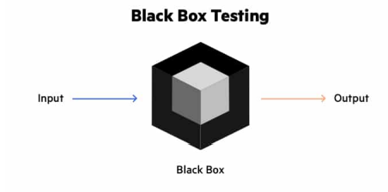
Black box testing
Black box testing is a software testing method where the tester does not check the internal code or structure of the system. It mainly focuses on providing inputs and observing the outputs of the software.

Slide 46
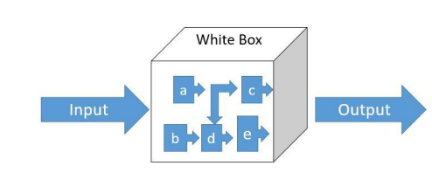
white box testing
White box testing is a testing method where the tester examines the internal structure, logic, and source code of the software. In this approach, the tester has full access to the code.
It includes:
Unit Testing
Integration Testing
Database Testing

Slide 47
TESTING Scenario
Table: Test Scenario 1
Scenario | Admin, User, VendorLogin testing
Input’s | Email, Password
Desired Output’s | User, Vendor and Admin will get access to their modules when they will give their valid email, password , otherwise they cannot get the access to the module.
Actual Output’s | A verified email address and password will grant access to the user and the administrator.
Verdict | Both the desired and actual outputs show that the system login is successful.

Slide 48
TESTING Scenario
Table 8.2 Test Scenario 2
Scenario | User Registration
Input’s | Name, Email, Password
Desired Output’s | When the user will give the valid email, they will get OTP on email notification and after conforming OTP their registration is done
Actual Output’s | The user can confirm their registration through notification whether their email is authentic.
Verdict | Actual and Desired Output show that the system register is operating as intended.

Slide 49
Project Demonstration

Slide 50
Limitations
Limited Payment options
Sign up with Google/ Face book will be added
Email cannot be used to retrieve a password.
Admin unable to add new catagory

Slide 51
Future Work
Augmented Reality (AR)
Live chatting
Password recovery via email & social login (Google/Facebook)
Local payment gateways (bKash, Nagad, Rocket)
Dedicated mobile application (Android/iOS)

Slide 52
Conclusion

Slide 53
Any Question

